Slide 1
COURSE: DATA SCIENCE TOPIC: Matplotlib (Data Visualization) INSTRUCTOR: REEMA MEMON

Slide 2
Introduction
In this lecture, you’ll learn how to use the Matplotlib (library/package to generate graphs for your data using python)
If you haven’t already installed matplotlib, type pip install matplotlib
(you can type !pip install matplotlib)

Slide 3
Introduction
Matplotlib is a powerful Python library used for creating static, animated, and interactive visualizations in a variety of formats. It is widely used in data science, machine learning, and scientific computing because it provides extensive tools to visualize data in a clear and effective way.
Significance of Matplotlib in Data Visualization:
Versatility: Matplotlib can create a wide variety of plots such as line plots, bar charts, scatter plots, histograms, and even more complex types like 3D plots.
Customization: It allows full control over the appearance of plots, including colors, styles, markers, gridlines, and much more, enabling users to tailor plots according to their needs.
Integration: Matplotlib integrates well with other popular libraries like NumPy, Pandas, and SciPy, making it easy to visualize data from these sources.
Overview of the pyplot Interface:
The pyplot module in Matplotlib provides a MATLAB-like interface, which is the most commonly used method for creating plots. It simplifies the process by allowing users to build plots step by step, similar to scripting in MATLAB.

Slide 4
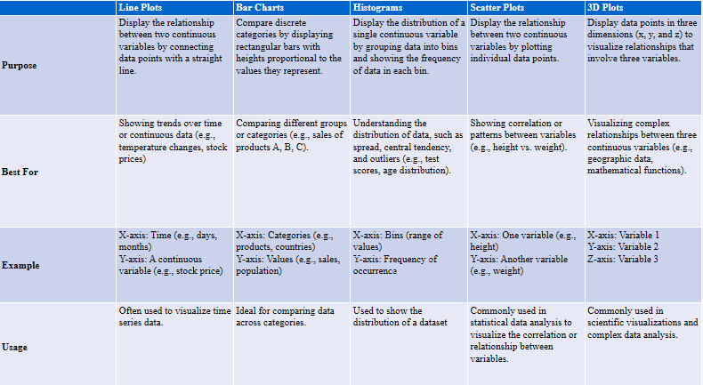

Slide 5
Basics
Plotting a 2D graph, with x and y axes, is straight forward.
Example: calories intake for 5 consecutive days
import matplotlib.pyplot as plt
import numpy as np
x_data = np.array([1, 2, 3, 4, 5])
y_data = np.array([2500, 3500, 2750, 2200, 2600])
plt.plot(x_data, y_data)
plt.show()

Slide 6
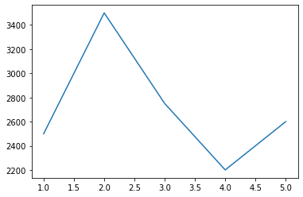
Output

Slide 7
This graph has several flaws, including: There is no indication of the variable on x-axis There is no indication of the variable on y-axis There is no indication about what this data is about We need to address it, how?

Slide 8
Adding a title, x- and y- labels
We can add a title, as well as x- and y- labels to our graph in order to make it easier to understand:
x_data = np.array([1, 2, 3, 4, 5])
y_data = np.array([2500, 3500, 2750, 2200, 2600])
plt.plot(x_data, y_data)
plt.xlabel("day #")
plt.ylabel("calories intake")
plt.title("Daily intake of calories")
plt.show()

Slide 9
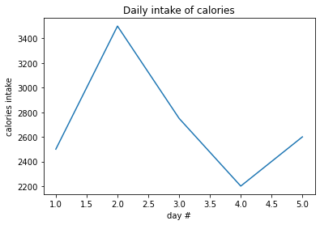
Output: Better?

Slide 10
Adding a grid
Although the graph was easier to understand after the addition of title and x/y labels, it is difficult to get precise values for x- and y-axes
We can improve this by adding a grid

Slide 11

plt.plot(x_data, y_data)
plt.xlabel("day #")
plt.ylabel("calories intake")
plt.title("Daily intake of calories")
plt.grid()
plt.show()

Slide 12
Creating aesthetically better graphs
We improve the aesthetic quality of the graph by
Changing line colour, style
plt.plot(x_data,y_data, color=‘red’)
You can also use different color codes, e.g= #7e94bb
Add markers
And changing marker size, colour, and type.

Slide 13
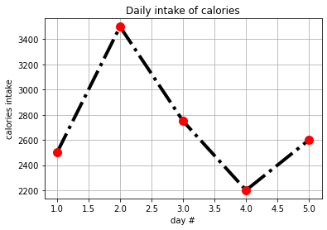
plt.plot(x_data, y_data, linestyle="-.", color="k", linewidth="4", marker="o", markersize=10, markeredgecolor="r", markerfacecolor="r")
plt.xlabel("day #")
plt.ylabel("calories intake")
plt.title("Daily intake of calories")
plt.grid()
plt.show()
Old graph New graph

Slide 14
Commonly used marker options include:
'o', '*', '.', 'x'
Commonly used colours include
'r', 'g', 'b', 'c', 'm', 'y' and 'k'
Commonly used line styles include
'-' = solid line
':' = dotted line
'--' = dashed line
'-.' = dash-dot line
'' = no line
Try this out:
plt.plot(x_data,y_data,'g+', markersize=15)

Slide 15
Alpha parameter:
plt.plot(x_data,y_data,alpha=0.5)
The values of alpha ranges from 0 to 1, where 0 means opaque and 1 means transparent. You can specify any value in between.
Try it out yourself.

Slide 16
Plot with multiple data:
days=[1,2,3,4,5,6,7]
max_t=[44,54,42,47,51,45,48]
min_t=[33,36,38,41,42,38,43]
avg_t=[42,43,39,40,45,44,40]
plt.title("Weather")
plt.xlabel("Days")
plt.ylabel("Temperature")
plt.plot(days,max_t, label="Max", color="Blue", linestyle="--")
plt.plot(days,min_t, label="Min", color="Red", linestyle="--")
plt.plot(days,avg_t, label="Avg", color="Green", linestyle="--")
plt.legend(loc="best", shadow=True, fontsize="large") #loc= The location of the legend
plt.grid()

Slide 17
Subplots
We like to use subplots (multiple graphs in the same figure) when we want to view two sets of data simultaneously
Typically, for the sake of comparison
The subplot() function takes three arguments that describes the layout of the figure.
The layout is organized in rows and columns, which are represented by the first and second argument.
The third argument represents the index of the current plot.

Slide 18
# data of user 1
x_data_1 = np.array([1, 2, 3, 4, 5])
y_data_1 = np.array([2500, 3500, 2750, 2200, 2600])
# data of user 2
x_data_2 = np.array([1, 2, 3, 4, 5])
y_data_2 = np.array([2300, 3000, 2450, 2900, 2100])
plt.subplot(2, 1, 1)
plt.plot(x_data_1,y_data_1)
plt.xlabel("day #")
plt.ylabel("calories intake")
plt.title("Daily intake of calories")
plt.grid()

Slide 19
plt.subplot(2, 1, 2)
plt.plot(x_data_2,y_data_2)
plt.xlabel("day #")
plt.ylabel("calories intake")
plt.title("Daily intake of calories")
plt.xlabel("day #")
plt.ylabel("calories intake")
plt.title("Daily intake of calories")
plt.grid()
plt.tight_layout()
plt.show()

Slide 20
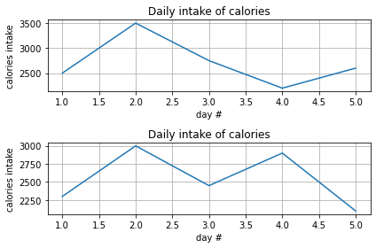
Output

Slide 21
Saving figures onto your drive
import matplotlib.pyplot as plt
import numpy as np
x_data = np.array([1, 2, 3, 4, 5])
y_data = np.array([2500, 3500, 2750, 2200, 2600])
plt.plot(x_data, y_data,
linestyle="-.", color="k", linewidth="4",
marker="o", markersize=10, markeredgecolor="r", markerfacecolor="r")
plt.xlabel("day #")
plt.ylabel("calories intake")
plt.title("Daily intake of calories")
plt.grid()
plt.savefig("D:/delete_image.png", dpi=300)
plt.show()

Slide 22
Bar charts using Matplotlib
x=np.array([1,2,3,4,5])
y=np.array([500,600,1000,400,200])
plt.barh(x,y)
plt.show()
The following code displays horizontal bar chart.
By using plt.bar(x,y) you can visualize the data in conventional bar chart format.
Search about the width and height parameter.

Slide 23
Scatter Plots using Matplotlib
With Pyplot, you can use the scatter() function to draw a scatter plot.
The scatter() function plots one dot for each observation. It needs two arrays of the same length, one for the values of the x-axis, and one for values on the y-axis:
plt.scatter()
plt.show()

Slide 24
Comparing two datapoints using scatterplot
x=np.array([1,2,3,4,5])
y=np.array([33,74,105,44,66])
plt.scatter(x,y)
x=np.array([1,2,3,4,5])
y=np.array([98,45,66,72,104])
plt.scatter(x,y)
plt.title('Comparing two datapoints')
plt.show()

Slide 25
Activities
Generate a graph for the following equations.
1
2
3
$$y\left(x\right)=x^{2}+2x−10$$
$$h\left(t\right)=11t −10$$
$$p\left(q\right)={0.5q}^{3}+{3q}^{2}−5q+5$$

